Slide 1
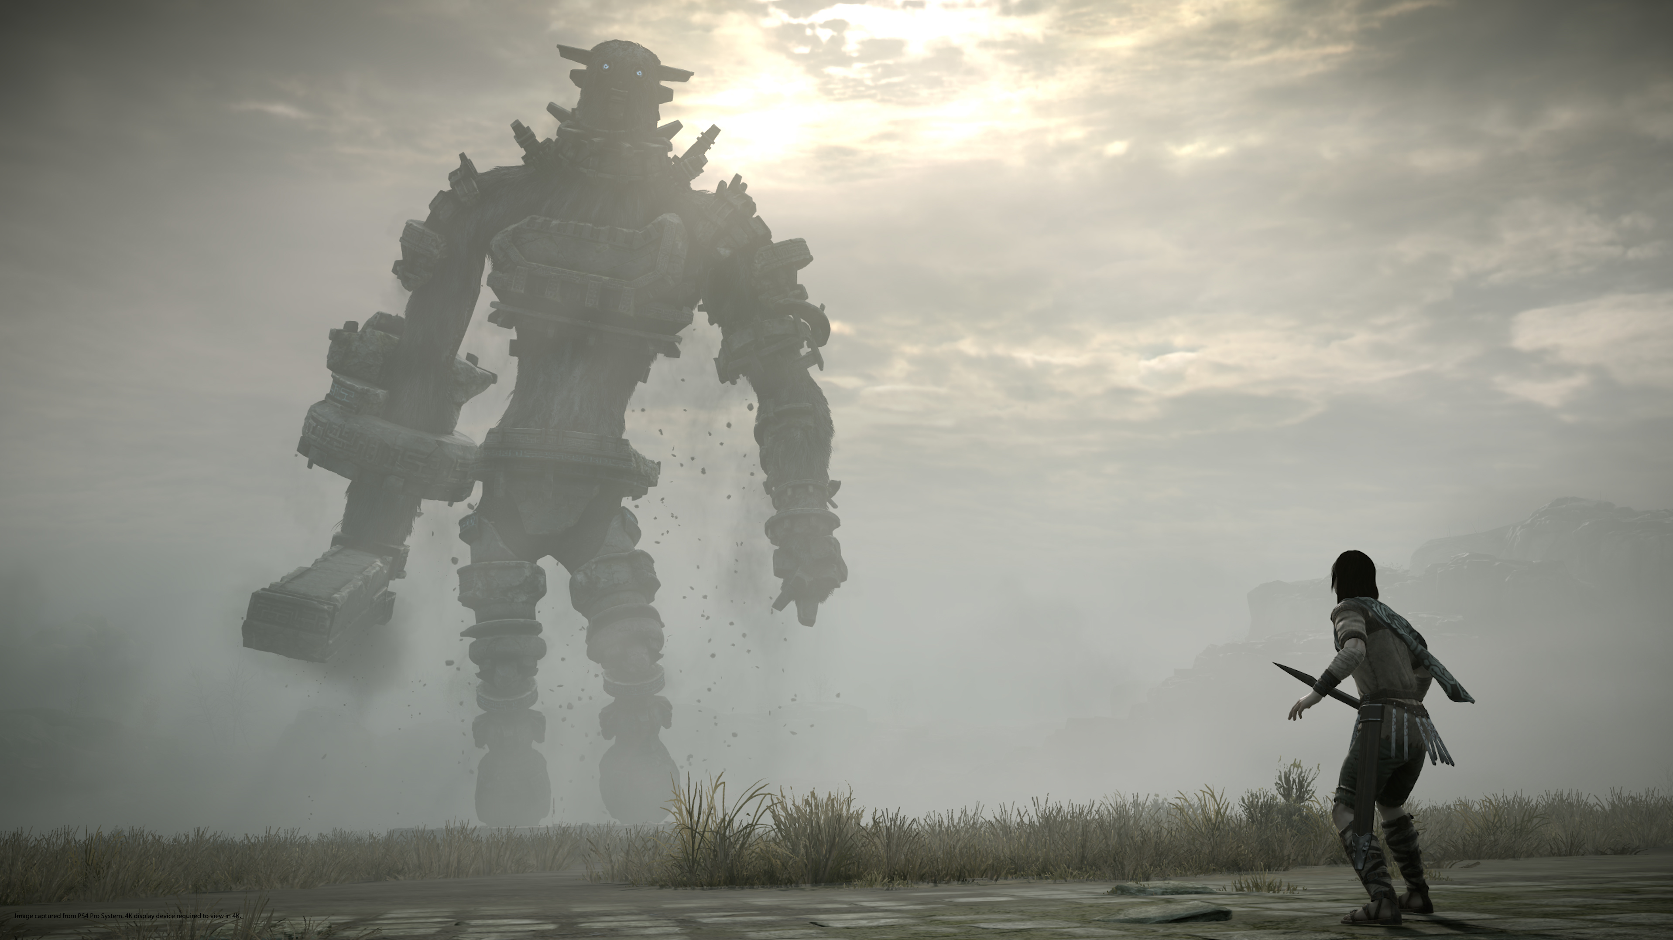
Class 3
Ellipsoid/Triangle and Sphere/AAB/Cylinder Collisions

Slide 2
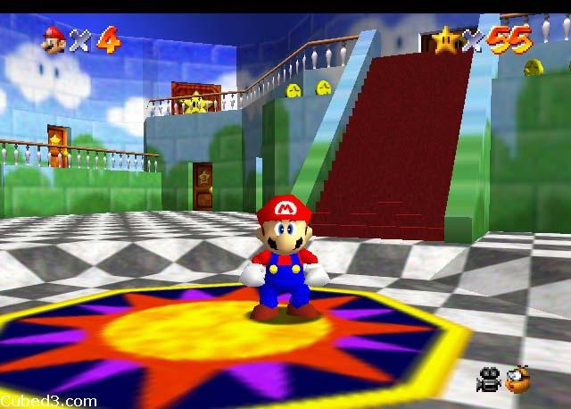
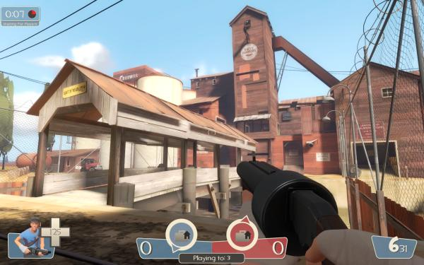
Platformer
A game that minimally involves platforms
Not based on any game in particular
Super Mario 64?
Team Fortress 2?
Completely up to you to make unique gameplay

Slide 3
Questions?
Platformer

Slide 4
Class 3
Sphere/AAB/Cylinder Collisions

Slide 5
New Types of Collisions
Box-box
Cylinder-box
Combination of line-line and circle-box in 2D
Sphere-box
Generalization of circle-box to 3D

Slide 6

AAB-AAB
Ensure overlap on each axis:
$A_{xmin}≤B_{xmax}$ AND $A_{xmax}≥B_{xmin}$
$A_{ymin}≤B_{ymax}$ AND $A_{ymax}≥B_{ymin}$
Notes:
That is not a negative sign.

Slide 7

Point-Circle
Check if the distance between the point and the center is less than or equal to the radius
${\left\|P−C\right\|}^{2}≤r^{2}$
P
C
C
d
r
P
r
d
Notes:
A circle is the entire collection of points that is within a given radius from a defined center point. That means if a circle has a radius of 10 and a center of 0, 0, it has all the points that are a distance of 10 or less away from the point, 0, 0. With this, we can determine how to do point-circle collision. We take the distance of the point from the center, and we check whether it is less than or equal to the radius. This is the distance algorithm.

Slide 8
Circle-AAB
Check if closest point to circle on AAB is in circle
Closest point: clamp C.x, C.y to [min.x, max.x], [min.y, max.y]
Then just do point-circle collision
C
r
d
C
P
r
P
min
min
d
min
P=C
r
d=0
max
max
max

Slide 9
Sphere-AAB
Easy to generalize to 3D from last 2 slides

Slide 10
Class 3
Ellipsoid/Triangle Collisions

Slide 11
Motivation
Triangle Collisions

Slide 12
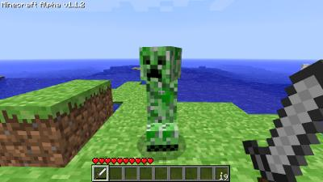
To Review
Entity movement models are dependent on collisions
Collision are different for:
Entity-entity collisions
Entity-environment collisions
All of this controls player movement

Slide 13
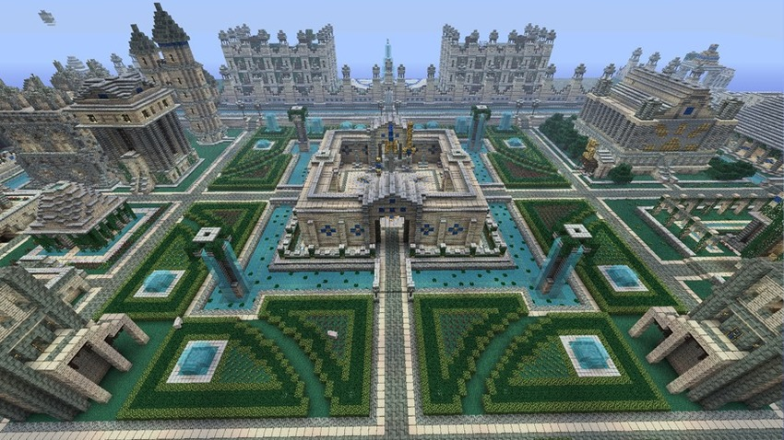
Current system is nice…
The current collisions we have looked at only work in an axis-aligned world
This is suitable for lots of games, such as Minecraft

Slide 14
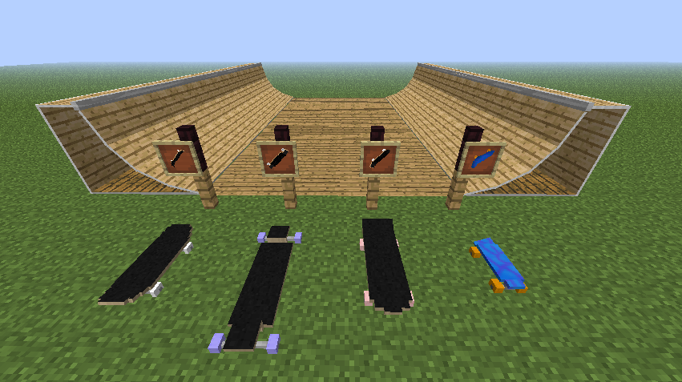
…but not always great
What if I want:
Slopes/ramps/curved surfaces
Non 90 degree angles
Environment objects of varying size

Slide 15
What do we really want?
Arbitrary environment representation
Not restricted to a grid or size
Arbitrary shapes in that environment
Allow for sloped surfaces
Allow for approximated curved surfaces
We want TRIANGLES!
What shape should entities be?

Slide 16
Shape: AABB
Pros:
Simple collision test for axis-aligned worlds
Cons:
Entities don’t have same diameter in all directions
Complicated collision test for arbitrary worlds
Entities “hover” on slopes
Stairs need special handling

Slide 17
Shape: Cylinder
Pros:
Entities have same diameter in all directions
Cons:
Collisions even more complicated by caps
Same slope hover problem
Same stairs problem

Slide 18
Shape: Upside-down cone
Pros:
Entities don’t hover on slopes
Entities naturally climb stairs (kinda)
Cons:
Still more complicated collision tests
Sliding like this may be undesirable

Slide 19
Shape: Ellipsoid
Pros:
Simpler collisions than any of the others for arbitrary triangle world
Entities closer to the ground on slopes
Entities still climb stairs (if they’re low enough)
Cons:
Entities “dip” down a bit going off edges

Slide 20
With this system…
Environment represented as an arbitrary mesh of triangles
Entities represented as ellipsoids
We need to build:
A basic mesh representation
Ellipsoid-triangle collisions
Ellipsoid raycasting
Triangle raycasting
Navigation through the world

Slide 21
Questions?
Non-Voxel Collisions

Slide 22
Ellipsoid Raycasting
Ellipsoid/Triangle Collisions

Slide 23

Raycasting a circle
Before we try 3D, let’s think in 2D
Ray: position and direction
$\overset{⃑}{r}(t)= \overset{⃑}{p} + t\overset{⃑}{d}$
$\overset{⃑}{d}$ is a normalized vector
Make every circle a unit circle at the origin (simpler to raycast)
Translate circle center and ray origin by -(circle center)
Scale circle and ray origin and direction relative to radius (1/$r$)
DO NOT RE-NORMALIZE the ray direction vector
Plug ray equation into equation for unit circle at the origin:
$$x2 + y2 ={ (\overset{⃑}{p}.x+\overset{⃑}{d}.x∗t)}^{2}+{(\overset{⃑}{p}.y+\overset{⃑}{d}.y∗t)}^{2} =1$$
$t$ is the only real variable left, solve with quadratic formula
$t$ gives you the intersection point for both the unit circle with the transformed ray, and the original circle with the untransformed ray
Because we haven’t re-normalized the direction
Notes:
* Do everything in coordinate system where unit circle at origin

Slide 24

Raycasting a Sphere
Unit sphere at the origin: $x2 + y2 + z2 =1$
Same transformations to both sphere and ray
Same ray equation (3 components)
Solve for $t$:
Calculate discriminant $(b2−4ac)$
< 0 means no collision (no real roots to quadratic)
= 0 means one collision (one root, ray is tangent to sphere)
> 0 means two collisions (two roots)
Plug $t$ into ray equation to get 3D intersection
Notes:
* Use discriminant to determine whether it’s worth using the quadratic formula, or if you’ll just get imaginary results

Slide 25
Raycasting an Ellipsoid

Slide 26
Change of space
rx and rz
Sphere intersections are way easier than ellipsoid intersections
Squish the entire world so the ellipsoid is a unit sphere!
Do detection in that space, convert back
Change of vector spaces:
Ellipsoid radius R = (rx, ry, rz)
Use basis (rx,0,0), (0,ry,0), (0,0,rz)
Ellipsoid space to sphere space: component-wise division by R!
ry
Divide by R
Notes:
Similar idea to raycasting arbitrary circle
“Basis vectors” determine basis

Slide 27

Raycasting an Ellipsoid
Convert from ellipsoid space to unit sphere space
Don’t forget to transform to origin as well as scale
Solve sphere equation for the new ray
Plug $t$ into the original ray equation to get intersection point

Slide 28
Questions?
Raycasting II – Ellipsoid Raycasting

Slide 29
Triangle Raycasting
Ellipsoid/Triangle Collisions

Slide 30
Raycasting to the environment
We can raycast to ellipsoids, great
Need some way to be able to raycast to our environment as well
This can be used for gameplay like bullets, lasers, line of sight, etc…
More importantly, you will use this in your sphere-triangle collision detection

Slide 31
Raycasting to the environment
Our environment is made up entirely of polygons
All polygons can be decomposed into triangles
Even ellipsoids are approximated by triangles when being drawn
So to raycast the environment, raycast to each triangle, and take the closest intersection
Notes:
* Brute force

Slide 32

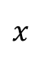
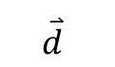
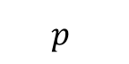
Ray-triangle intersection
Given: Ray casted from $\overset{⃑}{p}$ in the direction of $\overset{⃑}{d}$
Ray equation $\overset{⃑}{r}\left(t\right)=\overset{⃑}{p}+t\overset{⃑}{d}$
Goal: find $\overset{⃑}{x}$, the point on the triangle
There might not be a point $\overset{⃑}{x}$ which exists in that triangle
But there is a point $\overset{⃑}{x}$ that exists in the plane of that triangle (unless the ray is parallel to the plane)
$t$ value might just be negative (the point is in the opposite direction of the ray)
$$p$$
$$x$$
$$\overset{⃑}{d}$$
Notes:
* Unless ray parallel to plane, will need to special case

Slide 33
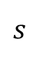
Ray-triangle intersection
Point x on triangle plane if (x – s) · n = 0
Where s is any point on the plane, such as one of the vertices
n is the normal of the plane
And x = p + t*d
Solve for t
(p + t*d - s) · n = 0
t = ((s - p) · n) / (d · n)
$$p$$
$$x$$
$$\overset{⃑}{d}$$
$$s$$
Notes:
Equation which is a test if x on plane
Plug ray equation into constraint

Slide 34



Ray-triangle intersection
So now we know the point P at which the ray intersects the plane of the triangle
But is that point inside the triangle or outside of it?
Point P (on plane) is inside triangle ABC iff P is on the left of all of the edges (assuming that edges are defined in counter-clockwise order i.e. $\overset{⃑}{AB},\overset{⃑}{BC},\overset{⃑}{CA}$)
A
A
P is to the left of $\overset{⃑}{AB},\overset{⃑}{BC},\overset{⃑}{CA}$
P is to the right of $\overset{⃑}{CA}$
P
P
B
B
C
C
Notes:
If you took 2D, this is the same as point in polygon test
“On the left” defined looking down the normal
All the triangles that you get will be defined in counter clockwise order (support code)

Slide 35

Ray-triangle intersection
A point $P$ is to the left of edge $AB$ if the cross product $AB×AP$ is in the same direction as the triangle normal
$BC×BP$, and $CA×CP$ are the other cross products
Can calculate normal of a triangle with cross product of two of its edges
$$N=\left(B−A\right)×(C−A)$$
Now you can compare to see if two vectors are in the same direction by seeing if their dot product is positive
$$(AB×AP)∙N>0$$
Notes:
* Maybe draw something up on the board with arrows

Slide 36
Questions?
Ellipsoid/Triangle Collisions

Slide 37
Ellipsoid Triangle Collisions

Slide 38
The basics
Entity represented by an ellipsoid
World represented by a set of triangles
Continuous collision detection
Analytically compute the time of and point contact, translate object to that point
Basic idea: formulate motion of the entity as a parametric equation, solve for intersection
Only works for simple motion (straight lines)
Notes:
Continuous!
The parametrized motion is the ray, based on velocity

Slide 39

General algorithm
Compute the line the player follows in one update
Kinda like raycasting start position to end position
Do ellipsoid-triangle sweep test for all triangles and take the closest result
Can optimize this using spatial acceleration data structure to test relevant triangles
Closest indicated by smallest positive $t$ value (proportion of update taken resulting in collision)
Compute remaining translation, sweep again
Cut off after a certain number of translations
You’ll do this next week
Notes:
“Sweep” is along direction of ray, not axis aligned
Sweeping out the volume of the sphere as it moves

Slide 40
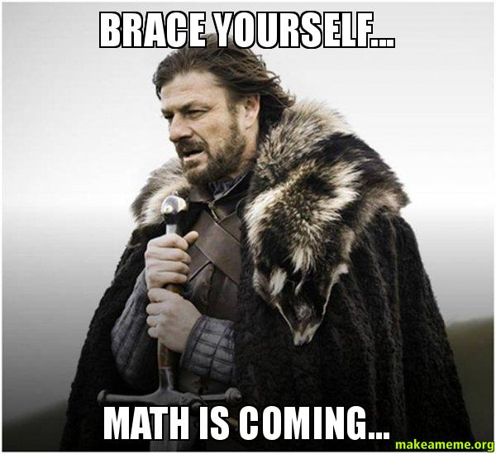
WARNING
There is A LOT of vector math we’re about to get into
You DO NOT need to understand all of it
Though it may help with debugging
This is not a math class
Don’t memorize the derivations
Don’t re-invent the wheel

Slide 41
Ellipsoid-Triangle Collisions
Collisions III

Slide 42

Ellipsoid-triangle collisions
Analytic equation for a moving sphere:
Unit sphere moving from $A$ at $t=0$ to $B$ at $t=1$
Location of center: $A+\left(B−A\right)t$
Point $P$ on the sphere at $t$ if ${\left\|[A+\left(B−A\right)t]−P\right\|}^{2}=1$
Solve for $t$ in unit sphere space
Value stays the same in ellipsoid space!
Split collision detection into three cases:
Triangle interior (plane)
Triangle edge (line segment)
Triangle vertex (point)

Slide 43
Sphere-interior collision
Intersect moving sphere with a plane
If intersection is inside triangle, stop collision test
Interior collision always closer than edge or vertex
If intersection is outside triangle, continue test on edge and vertices
NO short circuit
Player's sphere
1 unit
A
B

Slide 44

Sphere-interior collision
Sphere-plane intersection:
Same thing as ray plane using the point on the sphere closest to the plane!
Given plane with normal $N$, closest point is $A−N$
We assume that the sphere starts “above” the triangle
Don’t care about colliding a sphere starting below the triangle, this should never happen
Player's sphere
1 unit
A - N
N
B - N
Notes:
By “above”, we mean on the side of the outward facing normal – side of the triangle that is drawn
There is only a collision if closest point collidess

Slide 45
Sphere-interior collision
Point P on plane if (P – S) · n = 0
Where S is any point on the plane, such as one of the vertices
Turn the problem into ray/triangle!
Again, when the sphere hits the plane
May not be in the triangle!
Repeat your point-in-triangle test!
Player's sphere
1 unit
A - N
N
P
S
B - N
Notes:
* Same as triangle ray collision test, just changing parameters of the ray

Slide 46
Questions?
Ellipsoid/Triangle Collisions – Ellipsoid-Interior

Slide 47
Sphere-edge collision
Sphere vs. edge is the same as sphere vs. line segment
Intersect moving sphere with the infinite line containing the edge
Reject intersection if it occurs outside the line segment
How do we collide a moving sphere with a line?
Really just finding when sphere center passes within 1 unit of line
If we treat the line as an infinite cylinder with radius 1, and the motion of sphere center as ray we can use ray-cylinder intersection
Notes:
* Neat trick!

Slide 48
Analytic sphere-edge collision
Area of parallelogram formed by two vectors is the length of their cross product
Defining the surface of an infinite cylinder with vectors
Given two points C and D along cylinder axis
Point P on surface if
Area of gray parallelogram = Area of green parallelogram
This means that their height is equal, which means that the distance of p to the line segment is 1
D
1 unit
C
P
Green parallelogram area is equal to gray rectangle area if P is on cylinder surface.
D
C
P
Notes:
Draw vectors, point on cylinder if parallelogram formed by two vectors has same area as all other parallelograms of points on the cylinder
We know one of the areas

Slide 49

Analytic sphere-edge collision
Set $P=A+(B−A)t$
Since the area of a parallelogram formed by two vectors is the length of their cross product, we know we know that the point P satisfies ${\left\|\text{(}\text{P}\text{ – }\text{C}\text{) }\text{x}\text{ (}\text{D}\text{ – }\text{C}\text{)}\right\|}^{2}={\left\|D−C\right\|}^{2}$. So, we have
${\left\|\left(\left[A+\left(B−A\right)t\right]−C\right)×(D−C)\right\|}^{2}={\left\|D−C\right\|}^{2}$
Solving for $t$, you get quadratic ($at2+bt+c=0$) where
$a=\left\|(B−A)×(D−C)\right\|2$
$b=2((B−A)×(D−C))•((A−C)×(D−C))$
$c=\left\|(A−C)×(D−C)\right\|2−\left\|D−C\right\|2$
Solve using quadratic equation, use lesser $t$ value
B
D
P
C
A
Notes:
* Use equality on previous page, for parallelogram areas

Slide 50
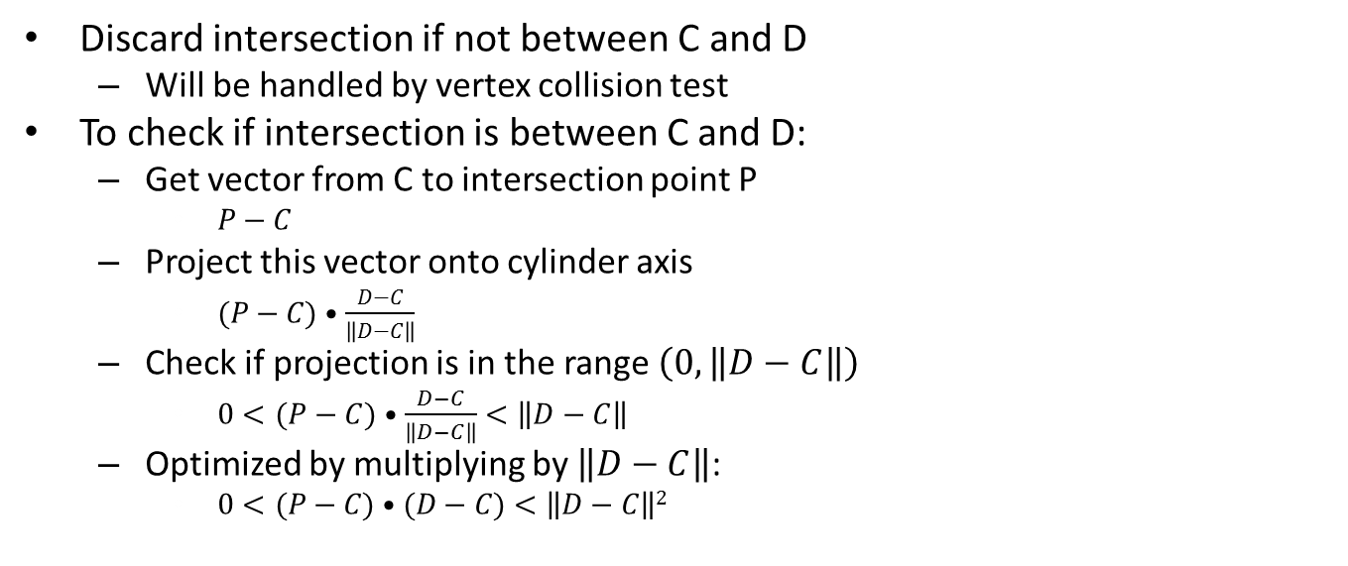
Analytic sphere-edge collision
Discard intersection if not between C and D
Will be handled by vertex collision test
To check if intersection is between C and D:
Get vector from C to intersection point P
$P−C$
Project this vector onto cylinder axis
$(P−C)•\frac{D−C}{\left\|D−C\right\|}$
Check if projection is in the range $\left(0,\left\|D−C\right\|\right)$
$0<(P−C)•\frac{D−C}{\left\|D−C\right\|}<\left\|D−C\right\|$
Optimized by multiplying by $\left\|D−C\right\|$:
$0<(P−C)•(D−C)<\left\|D−C\right\|2$
D
P
C

Slide 51
Questions?
Ellipsoid/Triangle Collisions – Ellipsoid-Edge

Slide 52
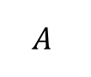
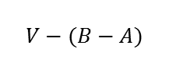
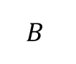
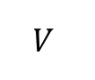
Analytic sphere-vertex collision
Collision test against a triangle vertex V
How do we collide a moving sphere against a point?
We know how to do a ray-sphere intersection test
Moving sphere vs. point is equivalent to sphere vs. moving point
Where the point moving in opposite direction
$$V−(B−A)$$
Triangle
$$V$$
$$A$$
$$B$$

Slide 53
Questions?
Ellipsoid/Triangle Collisions – Ellipsoid-Vertex

Slide 54
Class 3
Walking Around a Mesh

Slide 55
A few more details…
We have figured out how to detect ellipsoid triangle collisions, but we have not discussed how to respond to them in a helpful way
If we tried to walk around a triangle mesh without considering some extra details, we would stick to the ground!
Why? Notice that we haven’t discussed minimum translation vectors!

Slide 56
The “MTV Slide”
The green ellipsoid is the starting position of the ellipsoid during the tick
The red ellipsoid is the ending position of the ellipsoid during the tick, assuming no collisions happened
The first orange ellipsoid is the position of the ellipsoid at the first collision (with the blue triangle) that happens as the green ellipsoid moves in the direction of the red ellipsoid
The second orange ellipsoid is the same as the first orange ellipsoid except it has been slid forward in the direction of the red ellipsoid in such a way that it does not collide with the blue triangle
2
1

Slide 57
The “MTV Slide”
We will call this behavior the “MTV slide”
Adding this functionality prevents us from sticking to the ground!
The next slide has pseudocode explaining how to implement this
Essentially, you take the vector connecting the first orange ellipsoid to the red ellipsoid and subtract away the component of that vector that is not orthogonal to the triangle’s normal
Then you add the resulting vector to the position of the first orange ellipsoid to get the second orange ellipsoid
Note that the second ellipsoid could run into another triangle
So, we need to repeat our collision detection and MTV slide steps for some maximum number of translations, or until we come across an iteration where we can safely slide without hitting another triangle
2
1

Slide 58
MTV Slide Pseudocode
ellipsoidTriangleCollisions(initial_pos, final_pos):
collisions = []
curr_pos = initial_pos
for i in range(MAX_TRANSLATIONS):
c = getClosestCollision(initial_pos, next_pos)
if (c.t == INFINITY):
return (collisions, next_pos)
else:
curr_pos = c.pos
d = final_pos – curr_pos
// you might need to play around with d_corrected in order to correctly handle
// downward-facing walls
d_corrected = d - dot(d, c.normal) * closest_collision.normal
next_pos = curr_pos + d_corrected
collisions.append(c)
return (collisions, curr_pos)

Slide 59
Improving Movement
Even with the MTV slide, we may stick to a wall if we are touching a wall and any component of our horizontal velocity is in the direction of the wall
In other words, if we “hug” a wall and try to move parallel to it, we will stick to the wall
This occurs because we repeatedly collide with the wall
We will also get weird behavior in the collision debugger
We can try to fix this problem by nudging the first orange ellipsoid slightly away from the triangle at every iteration…

Slide 60
MTV Slide Pseudocode
ellipsoidTriangleCollisions(initial_pos, final_pos):
collisions = []
curr_pos = initial_pos
for i in range(MAX_TRANSLATIONS):
c = getClosestCollision(initial_pos, next_pos)
if (c.t == INFINITY):
return (collisions, next_pos)
else:
curr_pos = c.pos + c.normal * .01 // nudge the ellipsoid slightly away from the triangle
d = final_pos – curr_pos
// you might need to play around with d_corrected in order to correctly handle
// downward-facing walls
d_corrected = d - dot(d, c.normal) * closest_collision.normal
next_pos = curr_pos + d_corrected
collisions.append(c)
return (collisions, curr_pos)

Slide 61
MTV Slide Pseudocode
ellipsoidTriangleCollisions(initial_pos, final_pos):
collisions = []
curr_pos = initial_pos
for i in range(MAX_TRANSLATIONS):
c = getClosestCollision(initial_pos, next_pos)
if (c.t == INFINITY):
return (collisions, next_pos)
else:
curr_pos = c.pos + c.normal * .01 // nudge the ellipsoid slightly away from the triangle
d = final_pos – curr_pos
// you might need to play around with d_corrected in order to correctly handle
// downward-facing walls
d_corrected = d - dot(d, c.normal) * closest_collision.normal
next_pos = curr_pos + d_corrected
collisions.append(c)
return (collisions, curr_pos)
This won’t work!

Slide 62
Improving Movement
Unfortunately, this nudging method can push us through a nearby triangle and make us fall into the floor!
An expensive way to deal with this is to nudge the ellipsoid and then check whether we collided with another triangle by nudging
This is an expensive fix because we could end up nudging the ellipsoid back and forth repeatedly as the ellipsoid escapes a crevice
But it works!

Slide 63
Final MTV Slide Pseudocode
ellipsoidTriangleCollisions(initial_pos, final_pos):
collisions = []
curr_pos = initial_pos
for i in range(MAX_TRANSLATIONS):
c = getClosestCollision(initial_pos, next_pos)
if (c.t == INFINITY):
return (collisions, next_pos)
else:
curr_pos = doNudge(curr_pos, c)
d = final_pos – curr_pos
// you might need to play around with d_corrected in order to correctly handle
// downward-facing walls
d_corrected = d - dot(d, c.normal) * c.normal
next_pos = curr_pos + d_corrected
collisions.append(c)
return (collisions, curr_pos)

Slide 64
Final MTV Slide Pseudocode
doNudge(curr_pos, collision):
nudge = collision.normal
pos_nudged = collision.center + nudge * .01
for i in range(MAX_NUDGES): // MAX_NUDGES can be something like 3
nudge_collision = getClosestCollision(curr_pos, pos_nudged)
if (nudge_collision.t == INFINITY):
curr_pos = pos_nudged
break
else:
// this code is necessary when we hit an edge shared by two triangles in exactly the wrong way
// this code tests whether we are nudged into the same triangle twice, and nudges you in the
// OPPOSITE direction if that happens
if (length(nudge_collision.normal – nudge) < EPSILON || length(nudge_collision.normal + nudge) < EPSILON):
nudge = -nudge_collision.normal
else:
nudge = nudge_collision.normal
pos_nudged = nudged_collision.center = nudge * .01
return curr_pos

Slide 65
Player Controls
Keep track of whether you are on the ground
If you are on the ground, then your y velocity is 0
If you are not on the ground, then your y velocity is not zero and gravity is acting upon you
You are on the ground if you collide with a triangle with an upward-facing normal (i.e. dot(n,(0,1,0) > 0)
If no movement keys are pressed (forward, backward, left, right) and we are on the ground, then we don’t need to move at all during the tick
These methods are a bit hacky, but they get the job done

Slide 66
Player Controls Pseudocode
The next slide has some pseudocode for handling player movement
There are lots of ways of solving this problem, so you should experiment!

Slide 67
Player Controls Pseudocode
// m_pos, m_on_ground, m_y_vel are member variables
handlePlayerMovement():
old_pos = copy(m_pos) // get a copy of the current position
moving_laterally = false // indicates whether we pressed WASD
key_presses = getKeyPresses()
look = camera.getLook()
dir = normalize(vec3(look.x,0,look.z))
perp = vec3(dir.z,0,-dir.x)
if (WASD_pressed(key_presses)): // if we pressed forward, backward, left, or right
moving_laterally = true
m_pos = translateHorizontally(key_presses, m_pos, dir, perp) // translate using dir and perp
if jumpButtonPressed():
m_on_ground = false
m_y_vel = JUMP_SPEED
y_vel += GRAVITY * seconds // GRAVITY is some negative number
if (m_on_ground):
if (y_vel < 0):
y_vel = 0
m_pos.y += y_vel // now m_pos contains the position of the player, assuming there are no collisions
m_pose, collisions = ellipsoidTriangleCollisions(old_pos, m_pos) // see ”mtv slide” pseudocode
m_on_ground = false // we need to assume that we are not on the ground
for collision in collisions:
if (dot(vec3(0,1,0), collision.normal) > 0):
m_on_ground = true
if (!moving_laterally && m_on_ground):
m_pos = old_pos

Slide 68
Class 3
Tips for Ellipsoid/Triangle Collisions

Slide 69
Collision Debugger
Tips for Ellipsoid/Triangle Collisions

Slide 70
“No, I don’t need a debugger”
Physics/collision bugs are the hardest type of bugs to track down
It will be much easier for you to find your mistakes in a controlled environment than for you to make them in your own code
It’s easier to test to make sure you’ve done it correctly

Slide 71
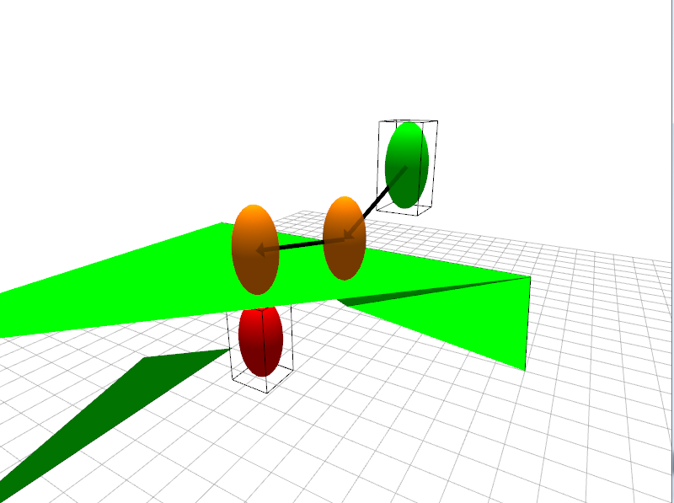
How does it work?
You can move around two of the ellipsoids here
The green ellipsoid represents an entity at the beginning of the tick
The red ellipsoid represents an entity at the end of the tick (without collision)
The other two ellipsoids are determined by the placement of the first two
The first orange ellipsoid represents where the entity will end up via colliding with the green triangles
The second orange ellipsoid represents where the entity slides to after hitting the surface (after the “MTV slide”)
Notes:
* Do a live demo

Slide 72
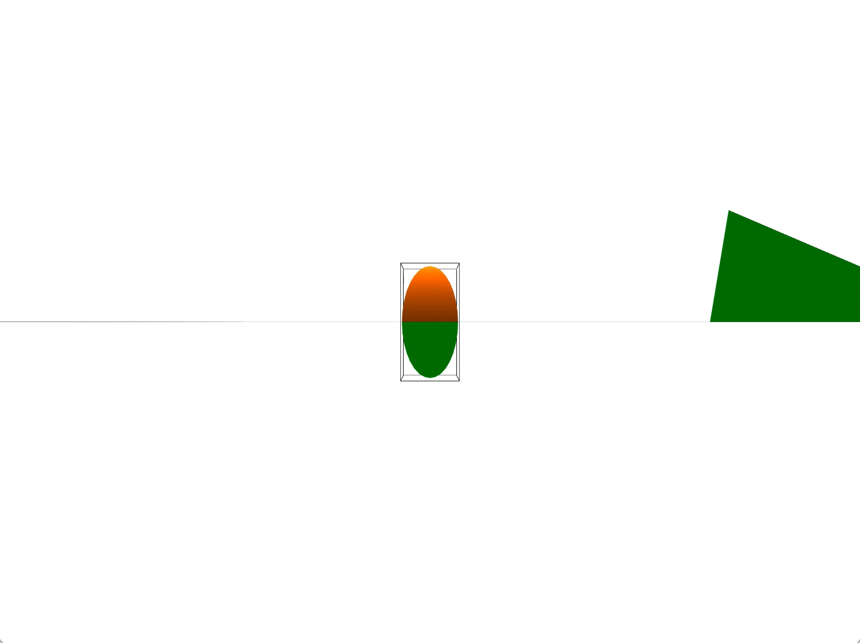
Stencil Demonstration Video
You can move the green and red ellipsoids around by clicking and dragging the boxes around them
Notice that dragging different sides of the box will move the ellipsoid in different ways
Notes:
* Do a live demo

Slide 73
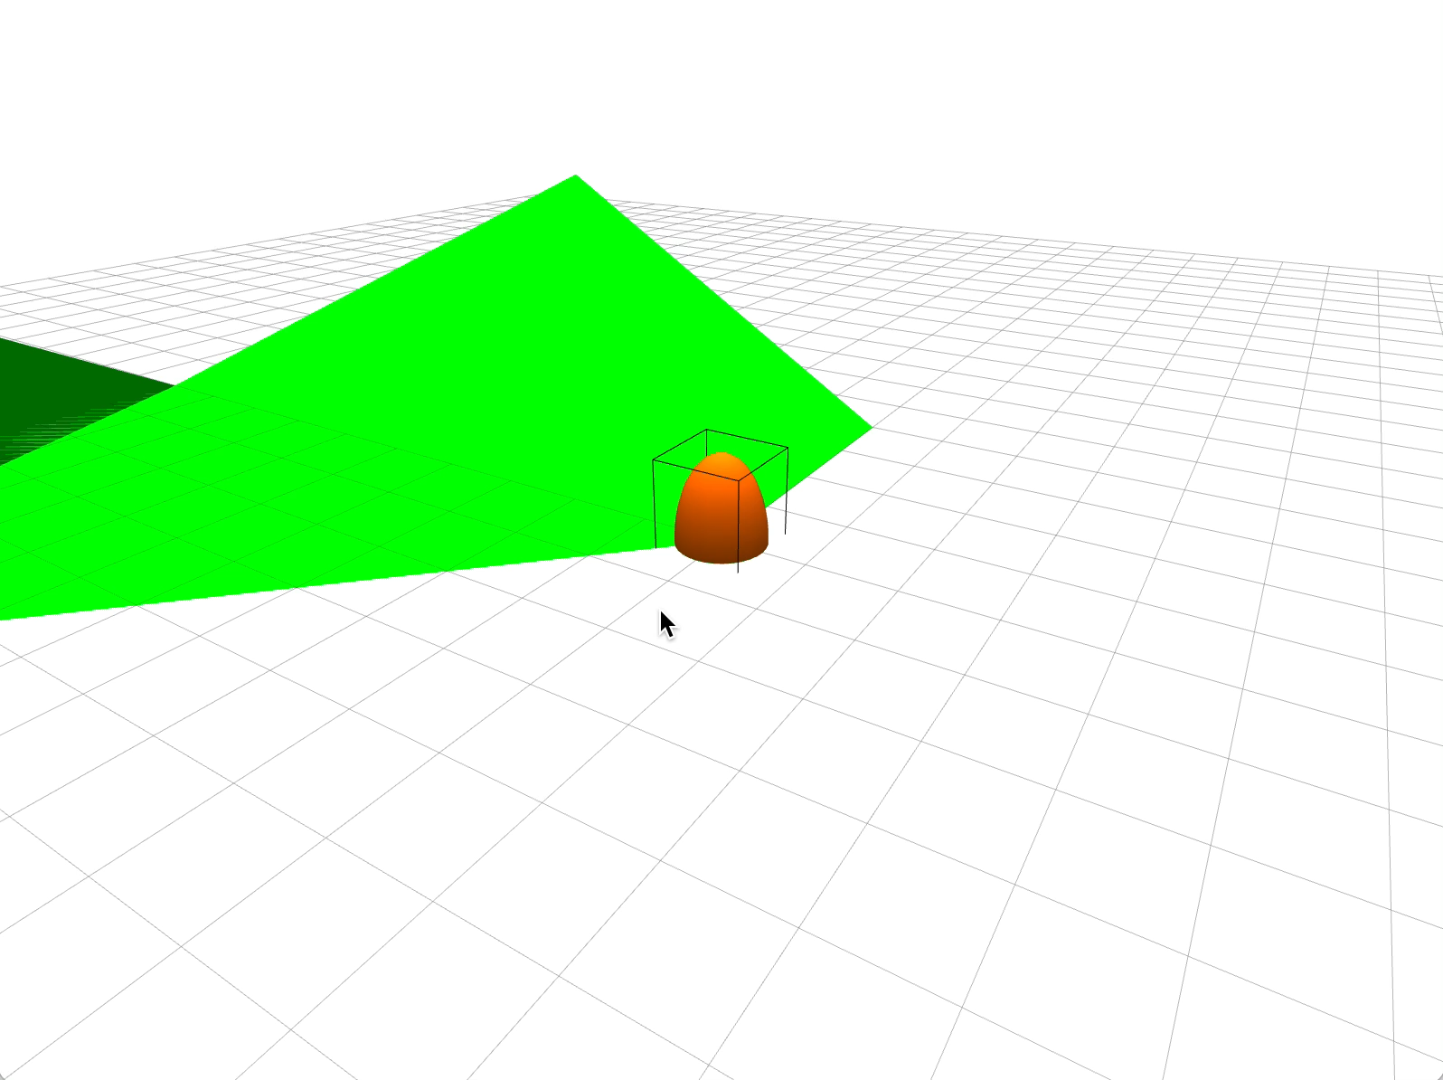
Solution Demonstration Video
Notes:
* Do a live demo

Slide 74
Where do I put my code?
We recommend that you put your raycasting and collision code in separate files (besides the support code files)
In order to change the position of the ellipsoids within the debugger …
Modify their positions in the view.cpp paintGL function (at the very top)

Slide 75
Collision Data
Your collision code should return a struct, minimally containing:
t-value in [0,1]
Normal
Point of contact
You may want to put “fancier” stuff in later
Notes:
* Although normal technically won’t be correct for this week, for reasons that you’ll see next week

Slide 76
More stuff
About two sided triangles …
Don’t worry about colliding ellipsoids with triangles that they are already “inside”
Don’t worry about colliding ellipsoids with triangles that they are “below”

Slide 77
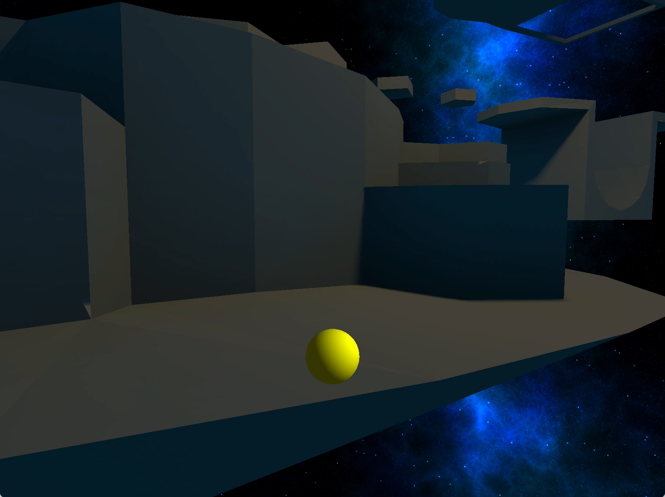
Goal for Platformer 1
Use the collision debugger to implement your collisions, and then use them to walk around an arbitrary mesh (see video)

Slide 78
Class 3
C++ Tip of the Week

Slide 79
Parametrized Inheritance
C++ Tip of the Week

Slide 80
Parametrized inheritance
// (Parent varies at compile time)
template<class Parent>
class Kid : public Parent
{
public:
Kid () : Parent() { ... };
method() {
Parent::doThis(true); doThat();
Parent::doThis(false); }
doThat() { ... };
}
// call Dad::doThis, Kid::doThat, Dad::doThis
Kid<Dad> f1; f1.method();
// call Mom::doThis, Kid::doThat, Mom::doThis
Kid<Mom> f2; f2.method();
Kid<Parent> f3; f3.doThat();
// the compiler just wrote 3 “Kid” classes for us
Kinda like generics in Java
But the thing in the braces is just text replaced by the compiler when given actual argument

Slide 81
Class 3
C++ Tip of the Week

Slide 82
Operator Overloading
C++ Tip of the Week (Part II)

Slide 83
Wait, Operator Overloading?
In C++, you can tell basic operators to work with classes (or enums!)
The basic arithmetic operations are commonly overloaded (+, -, *, /)
++, --, <<, and >> are also often overloaded
GLM overloads many operators to make vector math convenient

Slide 84
Operator Overloading
There are many legitimate uses of operator overloading
But it can be very easy to misuse it
In general, only use it to objectively make code clearer (to anyone who reads it)
even if myColor%(BLUE->RED[-7]) makes sense to you

Slide 85
Operator Overloading
You can even overload the function operator () for classes
Then you can call objects of that class like functions
But you could just give that class a named function, and call that function from your objects
You can overload the assignment operator = for classes too

Slide 86
Operator Overloading
The only operators you can’t overload are:
:: . (dot) ? : (ternary) sizeof
Meaning you can overload pretty much everything else:
% ^ | & ~ > < == ! [] () new -> delete
https://isocpp.org/wiki/faq/operator-overloading

Slide 87
Questions?
C++ Tips of the Week

